Slide 1
Strings

Slide 2
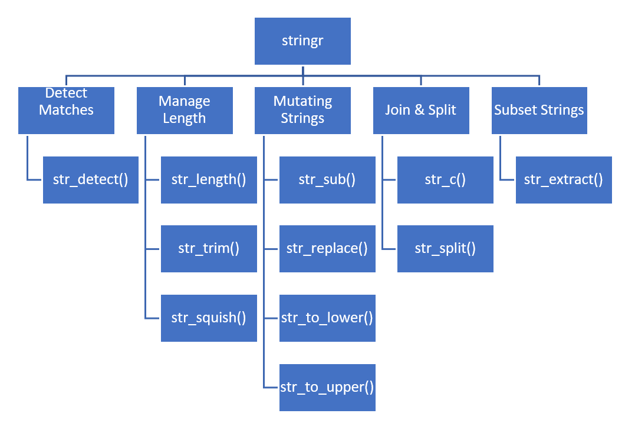

Slide 3
Detect Matches
str_detect(): Detects Patterns - checks if a string contains a specific pattern. Output: TRUE/FALSE.

Slide 4
Example 1: Detect whether the word fox is in the string or not.
my_string <- "The quick brown fox jumps over the lazy dog."
str_detect(my_string, "fox")
Output:

Slide 5
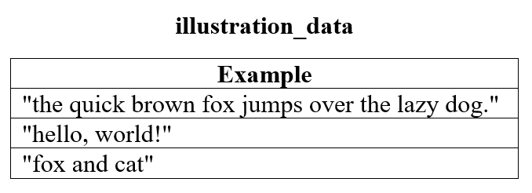

Slide 6
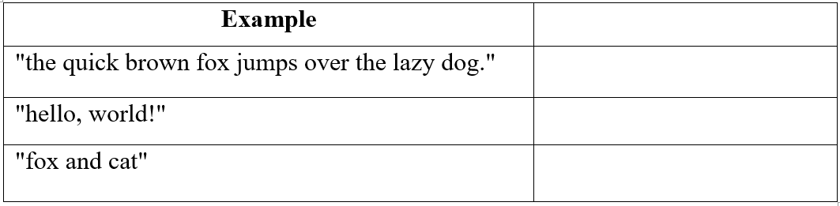
Example 2: Use str_detect in illustration data above to detect whether on each sentence there is the word fox.
example_2 <- illustration_data %>%
mutate(fox_check = str_detect(Example, "fox"))

Slide 7
Manage Length
str_length(): Finds the length (the number of characters) in a string.

Slide 8
Example 3: Count how many characters are in the following string.
my_string <- "Hello, World!"
str_length(my_string)
Output:

Slide 9
str_trim(): Trims white space - removes leading and trailing white space from a string.

Slide 10
Example 4: Remove the white space from the beginning and the end of the string.
my_string <- " Trim me! "
str_trim(my_string)
Output:

Slide 11
str_squish(): Removes extra white space withing a string, as well as the beginning, and the end.

Slide 12
Example 5: Remove all whitespace from the string.
my_string <- " Hello world from R! "
str_squish(my_string)
Output:

Slide 13
Mutating Strings
str_sub(): extracts substrings from a string.

Slide 14
Example 6: Extract the string from position 8 to position 13.
my_string <- "Extract this part"
str_sub(my_string, start = 9, end = 13)
Output:

Slide 15
str_replace(): replaces a pattern with another string.

Slide 16
Example 7: Substitute the word fox with the word cat.
my_string <- "The quick brown fox jumps over the lazy dog."
str_replace(my_string, "fox", "cat")
Output:

Slide 17
str_to_lower(): Changes the case to all lower case of a string.
str_to_upper(): Changes the case to all upper case of a string.

Slide 18
Example 8: Change the following string to all lower case and then to all upper.
my_string <- "Hello, World!"
str_to_lower(my_string) Output:
str_to_upper(my_string) Output:

Slide 19
Join & Split
str_c(): Combining Strings - concatenates strings together.

Slide 20
Example 9: combine the following two strings. Separate them by "-".
first_name <- "John"
last_name <- "Doe"
str_c(first_name, "-", last_name)
Output:

Slide 21
str_split(): splits a string into a character vector using a specified delimiter.

Slide 22
Example 10: Separate the following string by ",".
my_string <- "apple,banana,cherry"
str_split(my_string, ",")
Output:

Slide 23
Subset Strings
str_extract(): extracts the first occurrence of a pattern from a string.

Slide 24
Example 11: Extract the phone number from the following string.
my_string <- "Email me at john@example.com or call at 555-123-4567."
str_extract(my_string, "\\d{3}-\\d{3}-\\d{4}")
Output:

